Slide 1
MGS 723: Geodynamics
Class 21: Fluid Mechanics IV
(The stream function and postglacial rebound)
Main reference for today: Katz and England, University of Oxford notes

Slide 2
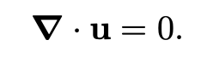

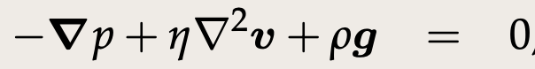
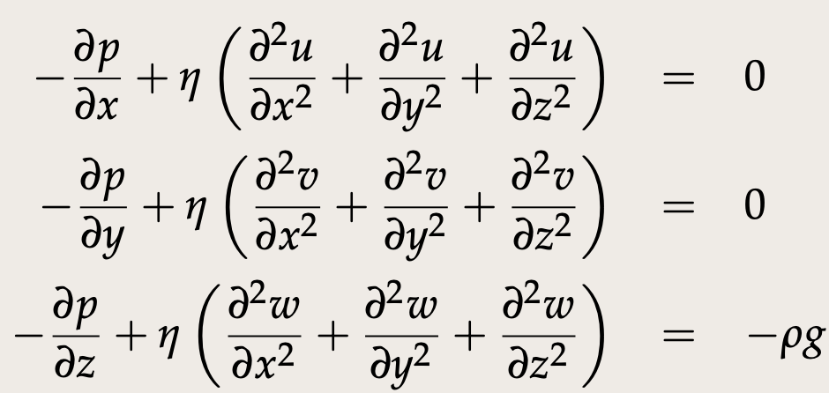
Stokes flow for incompressible, Newtonian fluid
Conservation
of mass
Conservation
of momentum
Vector form:
In full (Cartesian):

Slide 3
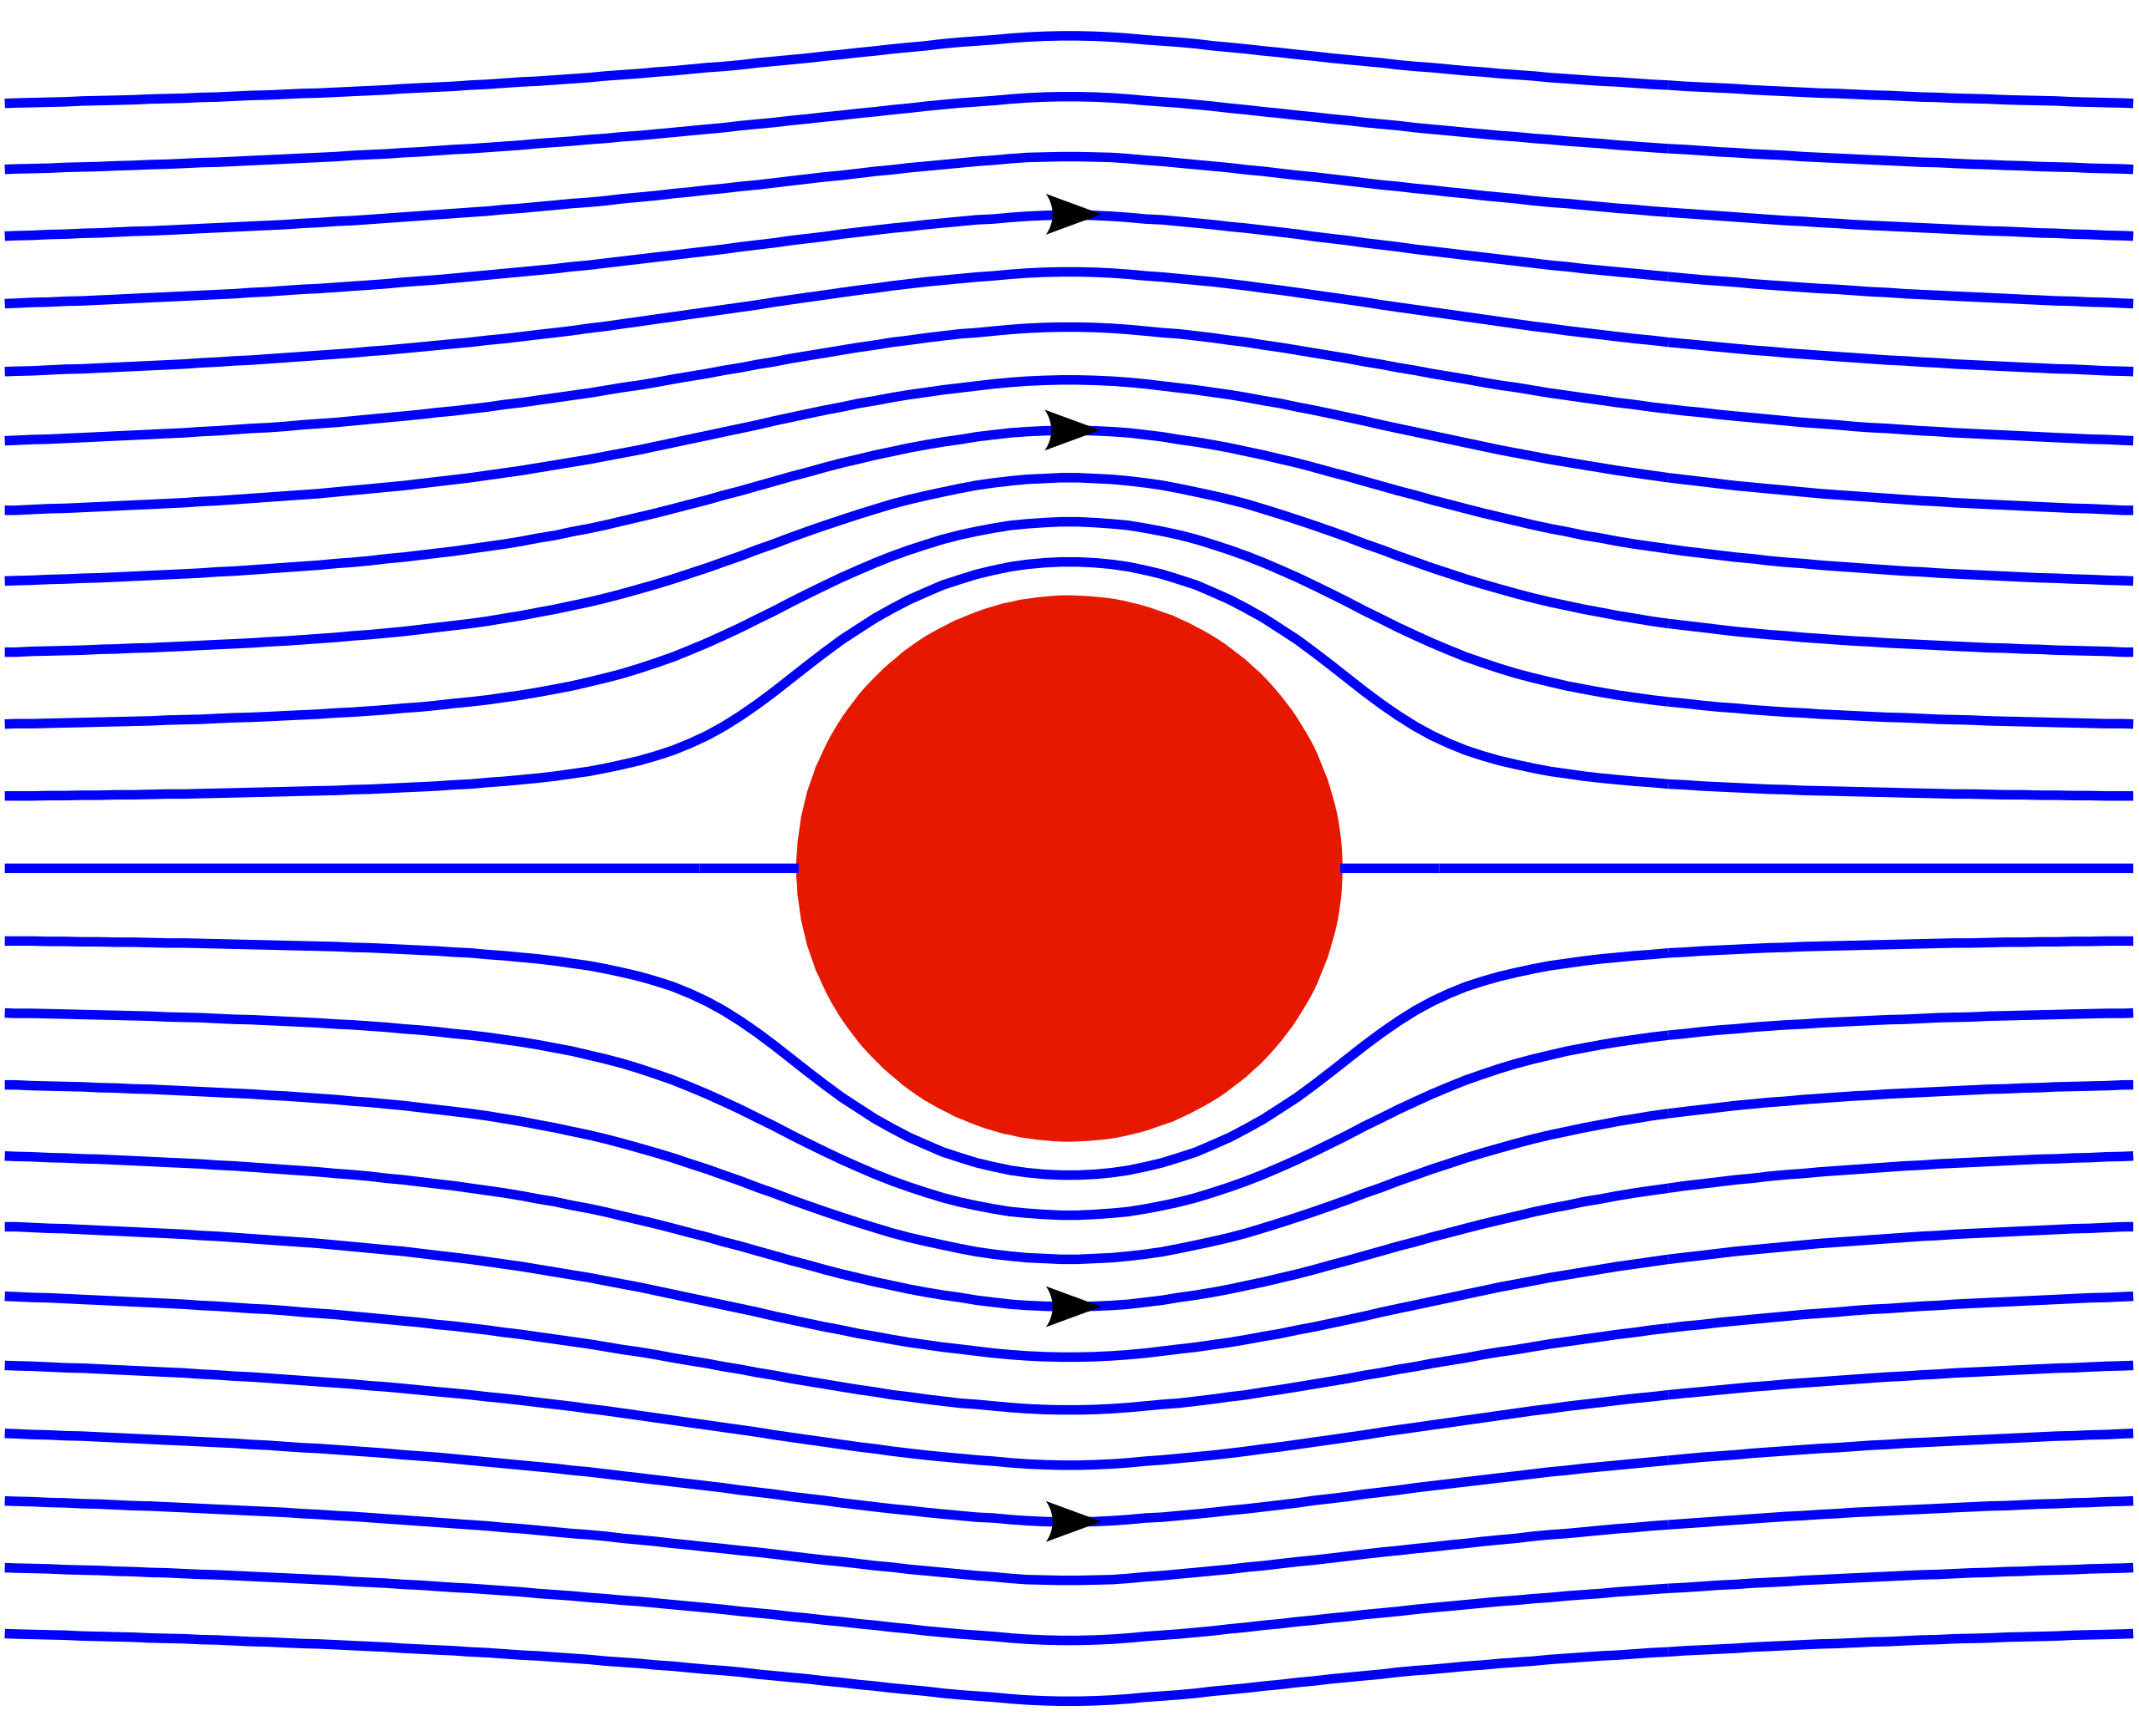
The stream function
Streamlines

Slide 4
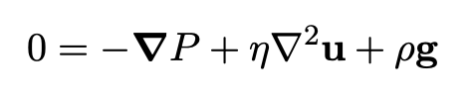
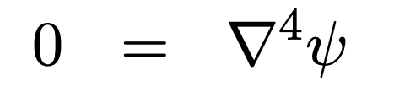
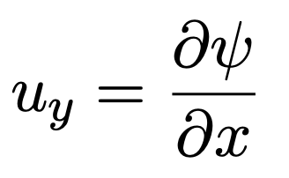
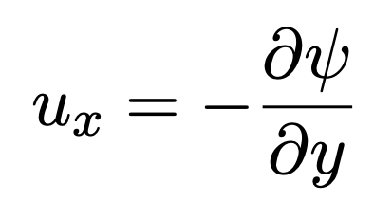
The stream function
A very convenient way to re-cast the incompressible Stokes equation in 2-D:
Where:

Slide 5
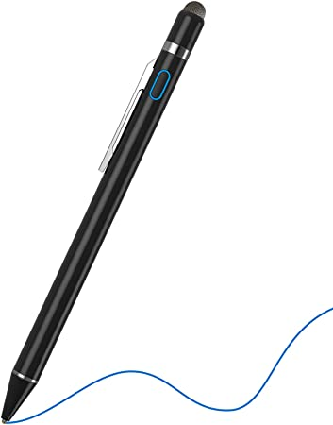
To the stylus…
Derive the stream flow form of the Stoke Equation

Slide 6
Streamlines are lines of constant $ψ$

Slide 7
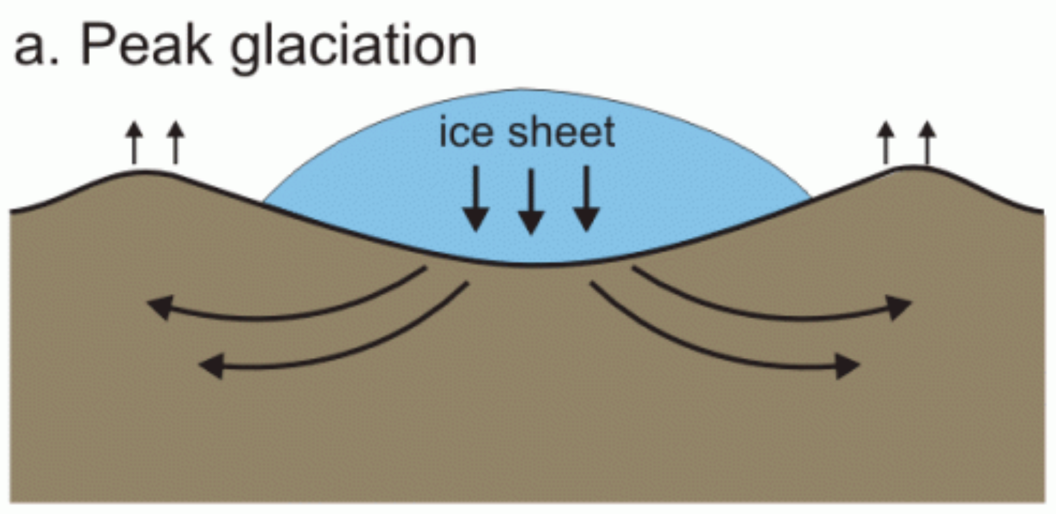
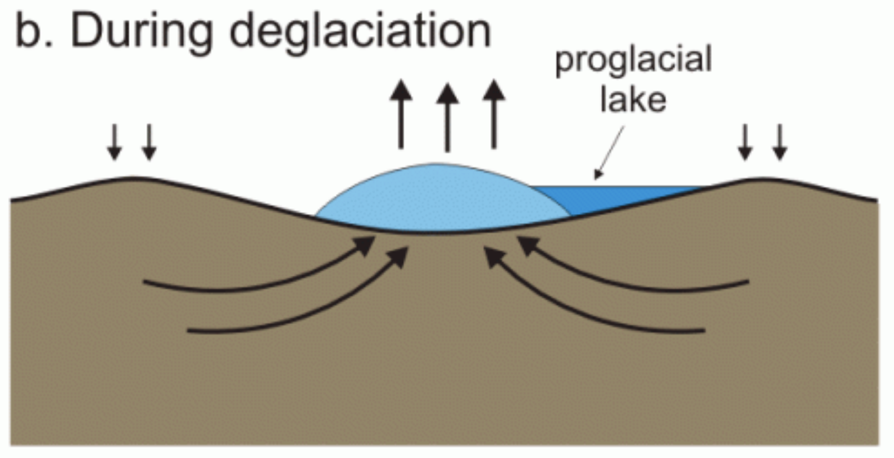
A classic application of the stream function:
Using postglacial rebound to estimate mantle viscosity

Slide 8

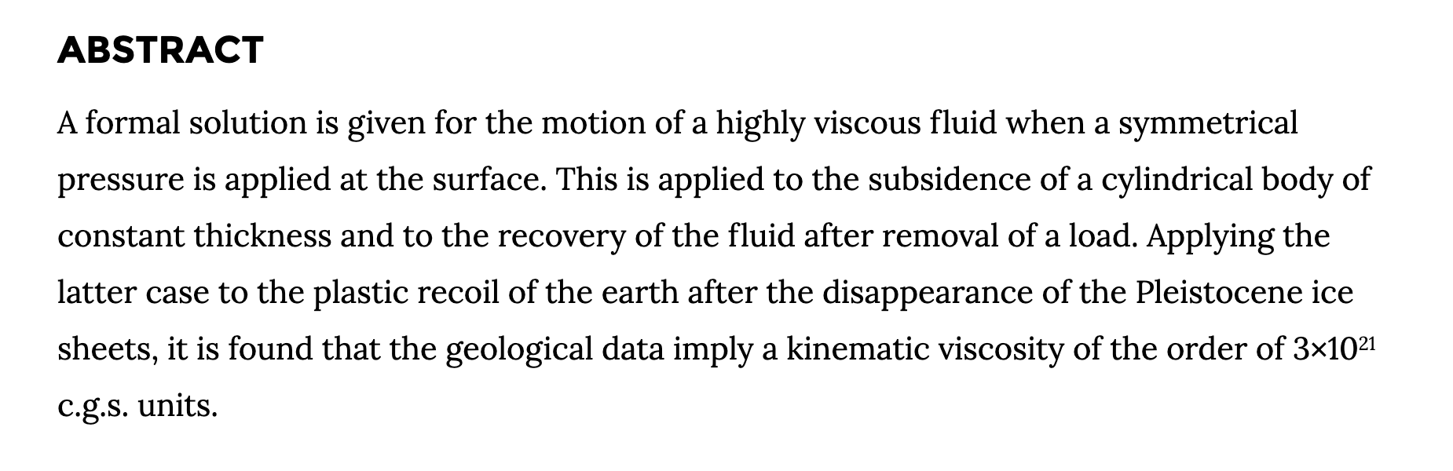
Postglacial rebound

Slide 9
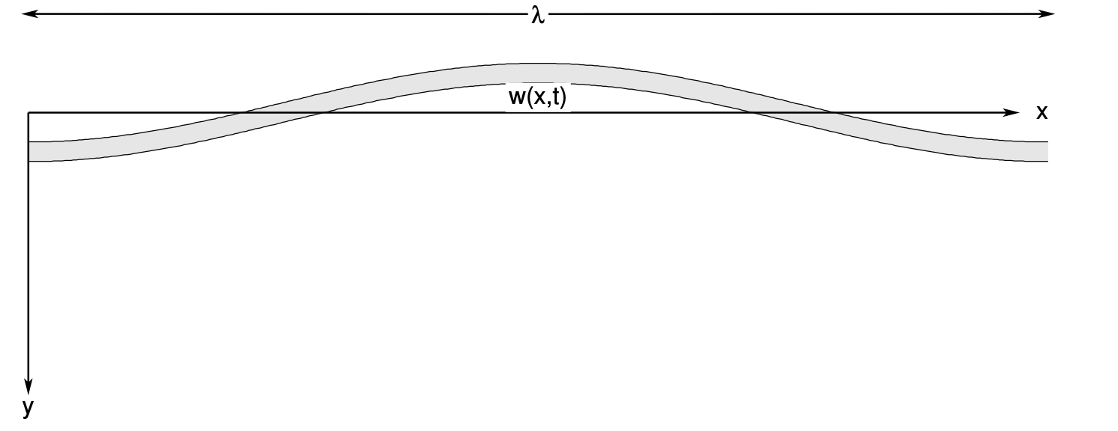
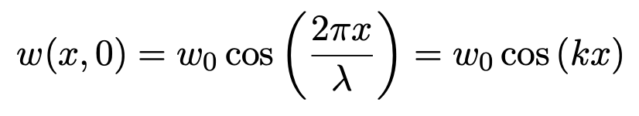
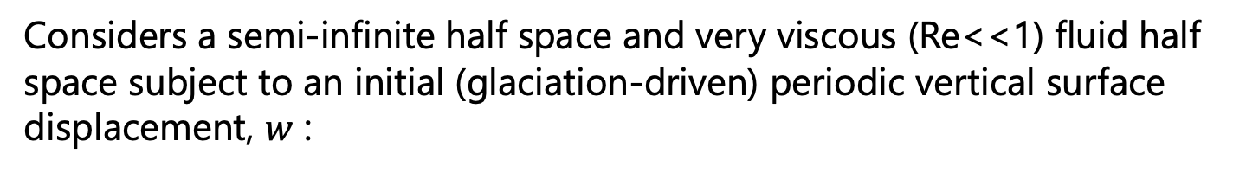
Postglacial rebound
Considers a semi-infinite half space and very viscous (Re<<1) fluid half space subject to an initial (glaciation-driven) periodic vertical surface displacement, $w$ :
$λ$ is the wavelength and $k$ is the wavenumber (assuming $w$<< $λ)$

Slide 10
Postglacial rebound
When the surface displacement (i.e., load) is removed, how quickly does the mantle flow (approx. as sketched) to erase the topography?
This is dictated by viscosity!
high pressure
low pressure
low pressure
mantle flow

Slide 11
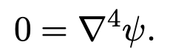
Postglacial rebound
When the surface displacement (i.e., load) is removed, how quickly does the mantle flow (approx. as sketched) to erase the topography?
This is dictated by viscosity!
high pressure
low pressure
low pressure
mantle flow
Constant density, incompressible, Re<<1:
We can use the stream function and solve

Slide 12
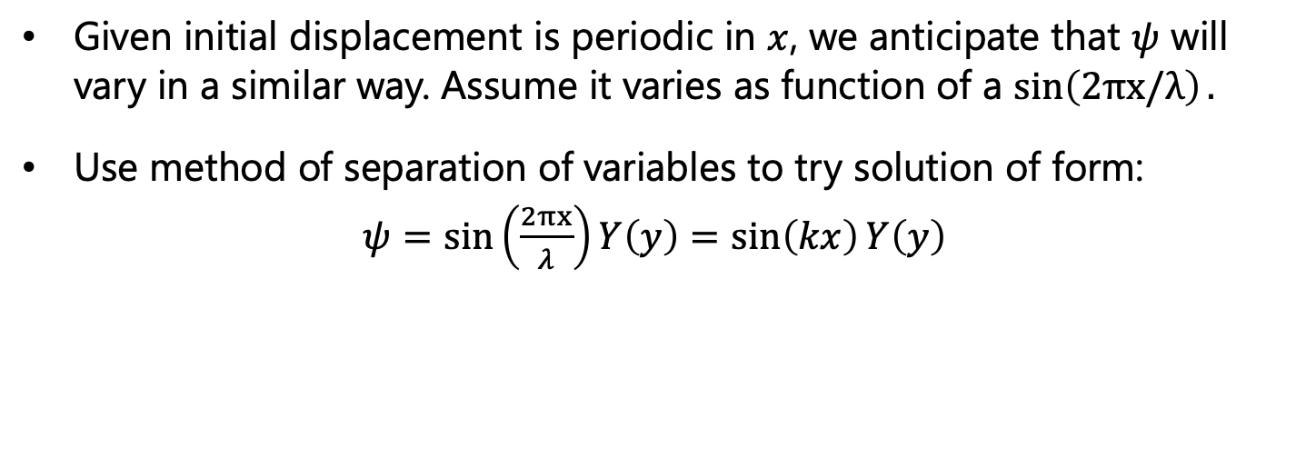
Postglacial rebound
Given initial displacement is periodic in $x$, we anticipate that $ψ$ will vary in a similar way. Assume it varies as function of a $\sin\left(2πx/λ\right).$
Use method of separation of variables to try solution of form:
$ψ=\sin\left(\frac{2πx}{λ}\right)Y\left(y\right)=\sin\left(kx\right)Y\left(y\right)$

Slide 13
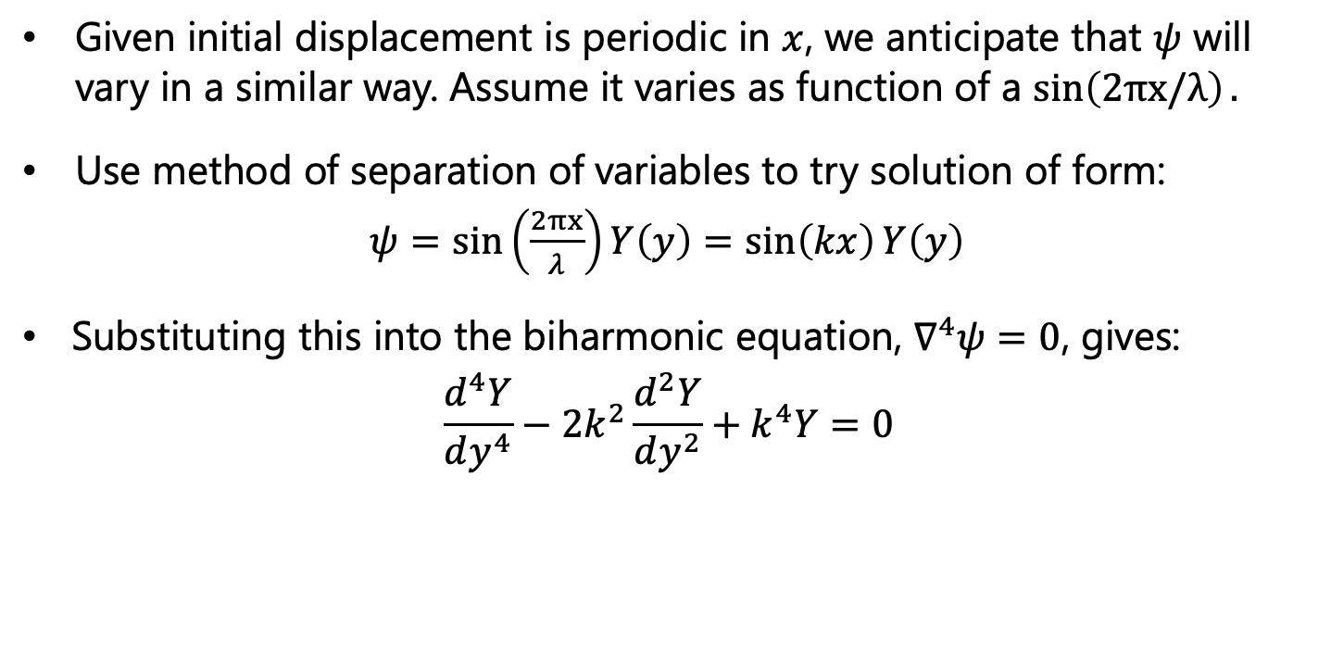
Postglacial rebound
Given initial displacement is periodic in $x$, we anticipate that $ψ$ will vary in a similar way. Assume it varies as function of a $\sin\left(2πx/λ\right).$
Use method of separation of variables to try solution of form:
$ψ=\sin\left(\frac{2πx}{λ}\right)Y\left(y\right)=\sin\left(kx\right)Y\left(y\right)$
Substituting this into the biharmonic equation, $∇^{4}ψ=0$, gives:
$$\frac{d^{4}Y}{dy^{4}}−2k^{2}\frac{d^{2}Y}{dy^{2}}+k^{4}Y=0$$
O(4th) ODE with linear coefficients

Slide 14
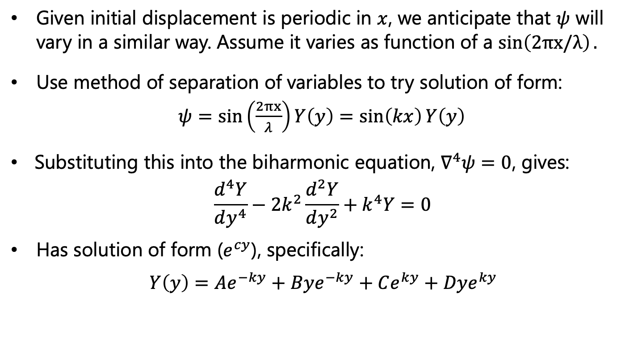
Postglacial rebound
Given initial displacement is periodic in $x$, we anticipate that $ψ$ will vary in a similar way. Assume it varies as function of a $\sin\left(2πx/λ\right).$
Use method of separation of variables to try solution of form:
$ψ=\sin\left(\frac{2πx}{λ}\right)Y\left(y\right)=\sin\left(kx\right)Y\left(y\right)$
Substituting this into the biharmonic equation, $∇^{4}ψ=0$, gives:
$$\frac{d^{4}Y}{dy^{4}}−2k^{2}\frac{d^{2}Y}{dy^{2}}+k^{4}Y=0$$
Has solution of form ($e^{cy}$), specifically:
$Y\left(y\right)=Ae^{−ky}+Bye^{−ky}+Ce^{ky}+Dye^{ky}$
O(4th) ODE with linear coefficients

Slide 15
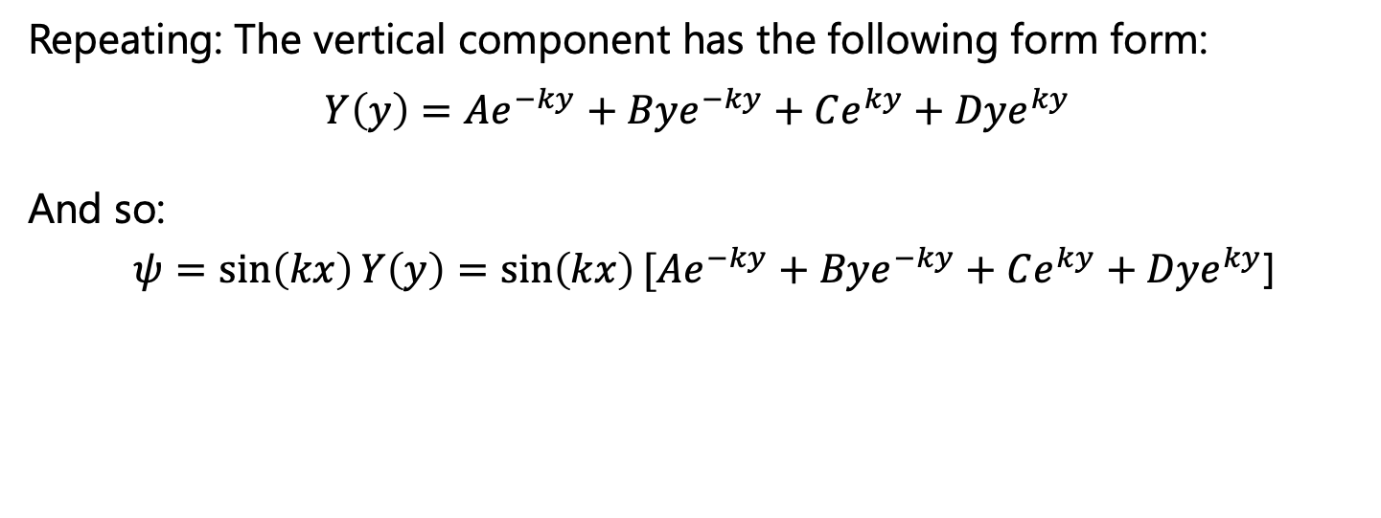
Postglacial rebound
Repeating: The vertical component has the following form form:
$Y\left(y\right)=Ae^{−ky}+Bye^{−ky}+Ce^{ky}+Dye^{ky}$
And so:
$ψ=\sin\left(kx\right)Y\left(y\right)=\sin\left(kx\right)[Ae^{−ky}+Bye^{−ky}+Ce^{ky}+Dye^{ky}$]

Slide 16
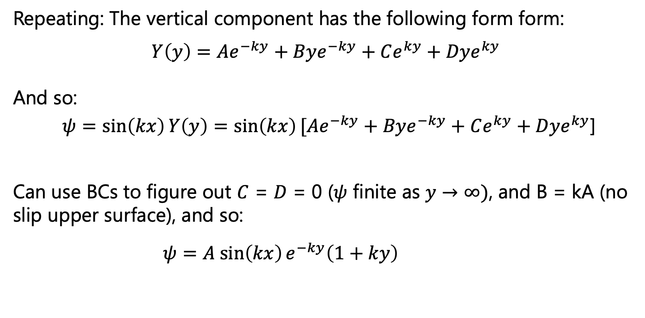
Postglacial rebound
Repeating: The vertical component has the following form form:
$Y\left(y\right)=Ae^{−ky}+Bye^{−ky}+Ce^{ky}+Dye^{ky}$
And so:
$ψ=\sin\left(kx\right)Y\left(y\right)=\sin\left(kx\right)[Ae^{−ky}+Bye^{−ky}+Ce^{ky}+Dye^{ky}$]
Can use BCs to figure out $C$ = $D$ = 0 ($ψ$ finite as $y→∞)$, and B = kA (no slip upper surface), and so:
$ψ=A sin\left(kx\right)e^{−ky}\left(1+ky\right)$

Slide 17
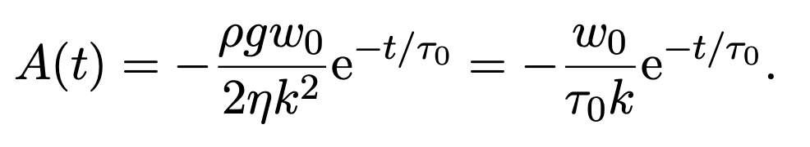
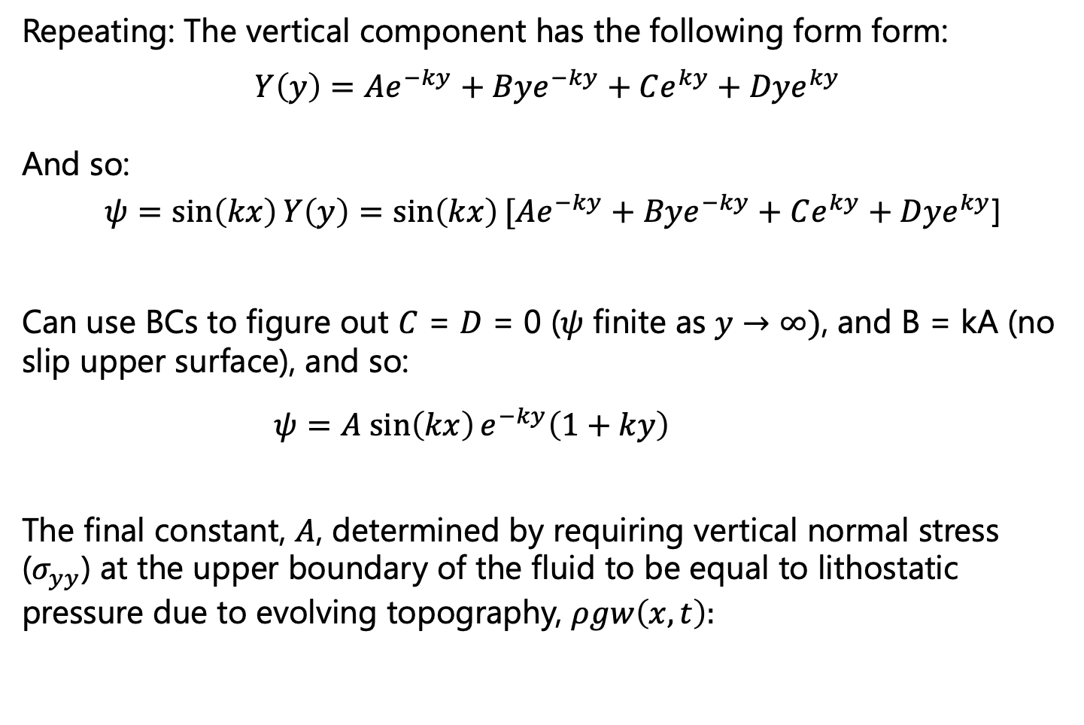
Postglacial rebound
Repeating: The vertical component has the following form form:
$Y\left(y\right)=Ae^{−ky}+Bye^{−ky}+Ce^{ky}+Dye^{ky}$
And so:
$ψ=\sin\left(kx\right)Y\left(y\right)=\sin\left(kx\right)[Ae^{−ky}+Bye^{−ky}+Ce^{ky}+Dye^{ky}$]
Can use BCs to figure out $C$ = $D$ = 0 ($ψ$ finite as $y→∞)$, and B = kA (no slip upper surface), and so:
$ψ=A sin\left(kx\right)e^{−ky}\left(1+ky\right)$
The final constant, $A$, determined by requiring vertical normal stress ($σ_{yy}$) at the upper boundary of the fluid to be equal to lithostatic pressure due to evolving topography, $ρgw\left(x,t\right):$

Slide 18
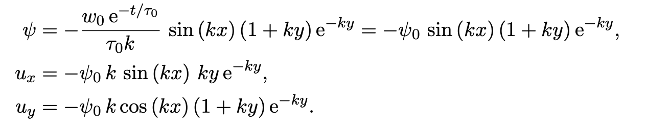
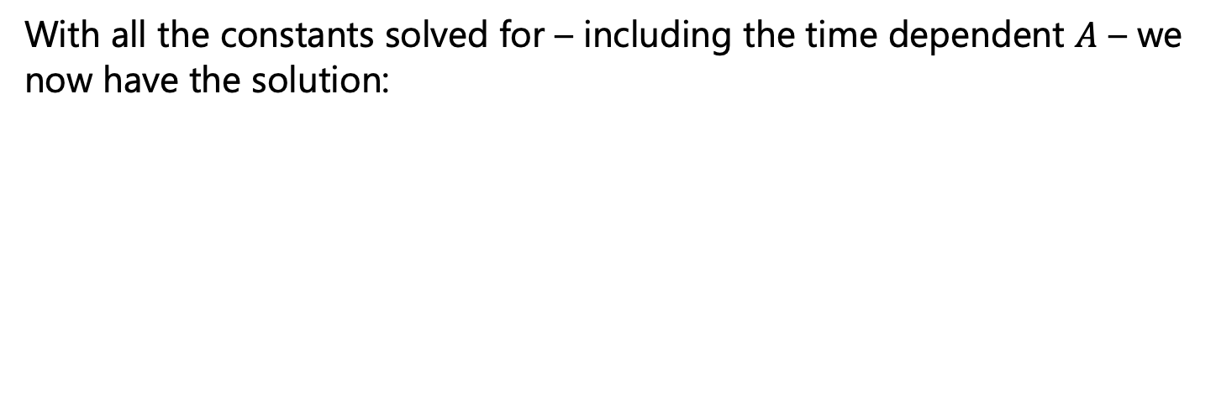
Postglacial rebound
With all the constants solved for – including the time dependent $A$ – we now have the solution:

Slide 19
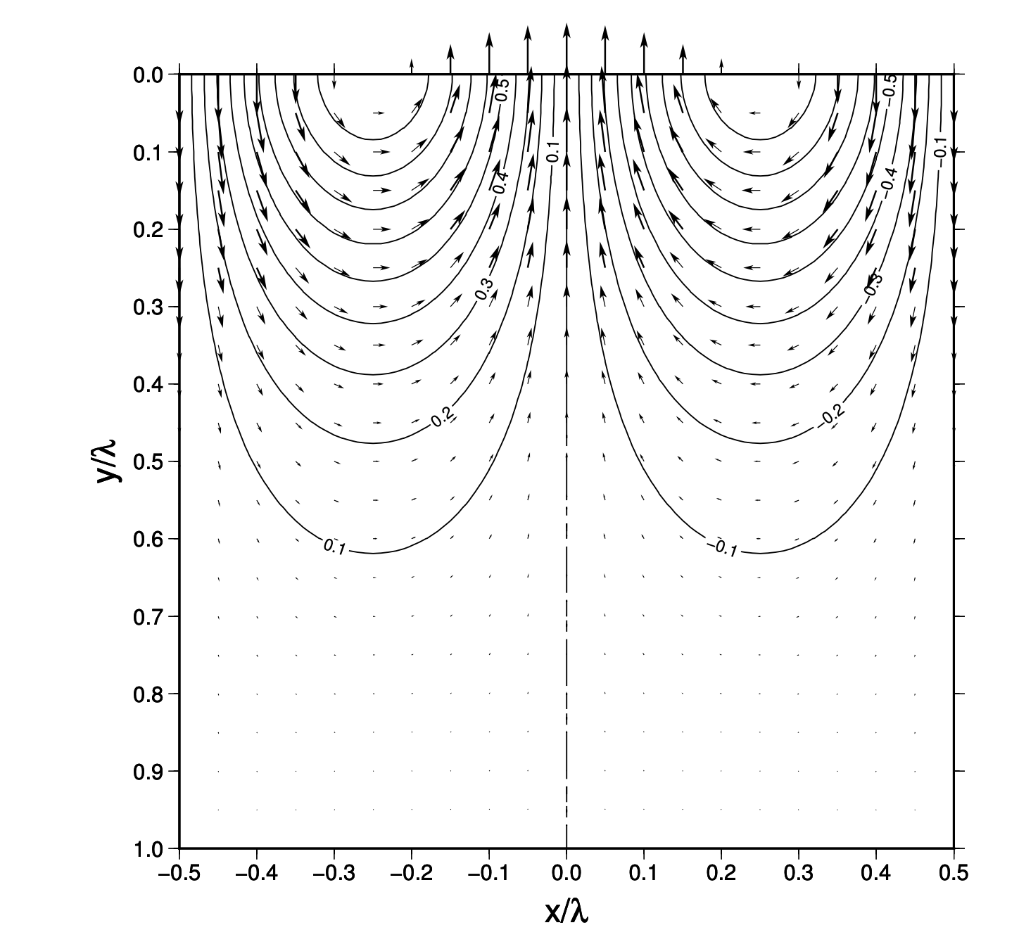
Postglacial rebound
With all the constants solved for – including the time dependent $A$ – we now have the solution:
Stream function solution for changing surface topography (topographic increase in middle, decrease towards boundaries)
Katz and England

Slide 20
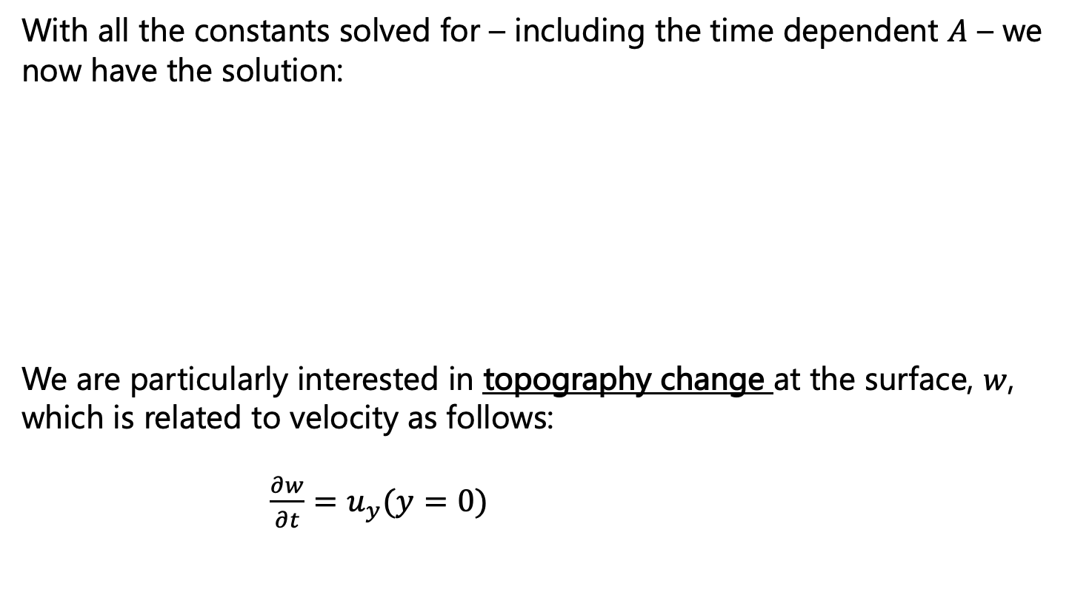
Postglacial rebound
With all the constants solved for – including the time dependent $A$ – we now have the solution:
We are particularly interested in topography change at the surface, $w$, which is related to velocity as follows:
$\frac{∂w}{∂t}=u_{y}(y=0)$

Slide 21
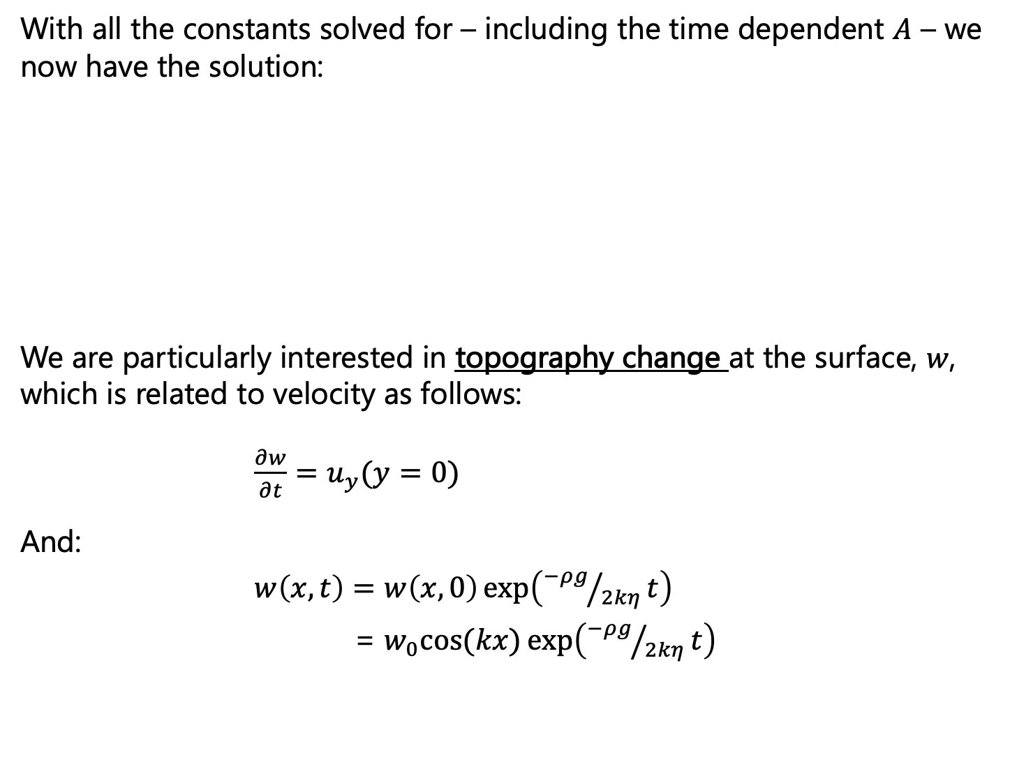
Postglacial rebound
With all the constants solved for – including the time dependent $A$ – we now have the solution:
We are particularly interested in topography change at the surface, $w$, which is related to velocity as follows:
$\frac{∂w}{∂t}=u_{y}(y=0)$
And:
$w\left(x,t\right)=w\left(x,0\right)\exp\left({−ρg}/{2kη}t\right)$
= $w_{0}cos⁡(kx)\exp\left({−ρg}/{2kη}t\right)$

Slide 22
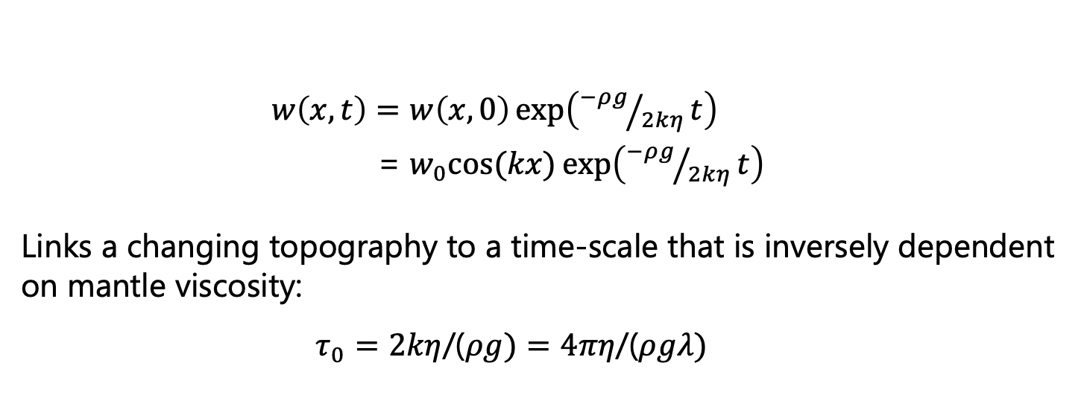
Postglacial rebound
$w\left(x,t\right)=w\left(x,0\right)\exp\left({−ρg}/{2kη}t\right)$
= $w_{0}cos⁡(kx)\exp\left({−ρg}/{2kη}t\right)$
Links a changing topography to a time-scale that is inversely dependent on mantle viscosity:
$τ_{0}=2kη$/($ρg)=4πη$/($ρgλ)$
The time constant for postglacial rebound

Slide 23
Postglacial rebound
$w\left(x,t\right)=w\left(x,0\right)\exp\left({−ρg}/{2kη}t\right)$
= $w_{0}cos⁡(kx)\exp\left({−ρg}/{2kη}t\right)$
Links a changing topography to a time-scale that is inversely dependent on mantle viscosity:
$τ_{0}=2kη$/($ρg)=4πη$/($ρgλ)$
The time constant for postglacial rebound
The Haskell Constraint

Slide 24
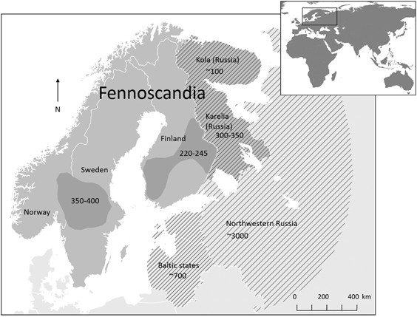
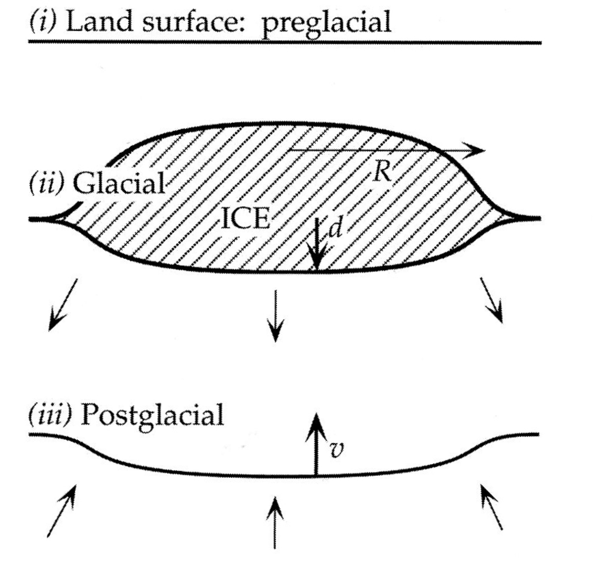
Postglacial rebound: Estimating viscosity
Fennoscandia ice sheets melted at about 11,000 years before present. Since then, relative sea-level in those regions has been falling, indicating uplift.

Slide 25
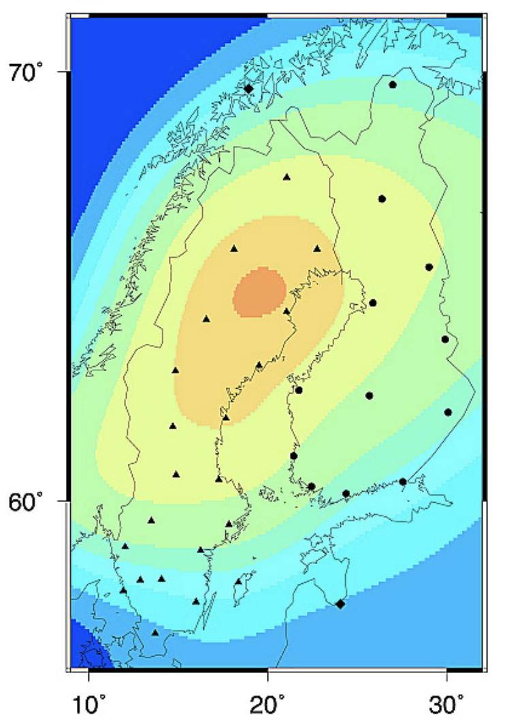
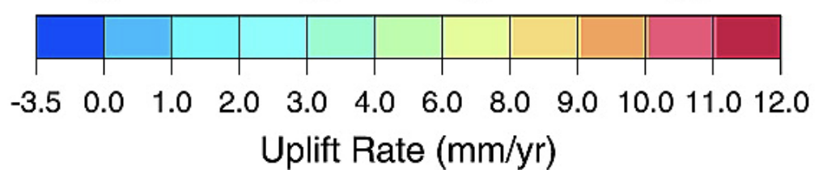
Postglacial rebound: Estimating viscosity
Fennoscandia ice sheets melted at about 11,000 years before present. Since then, relative sea-level in those regions has been falling, indicating uplift.

Slide 26
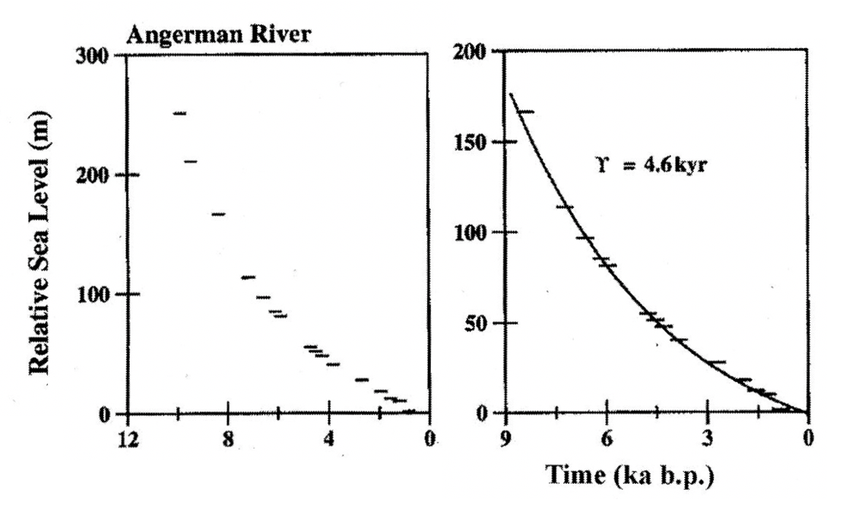
Postglacial rebound: Estimating viscosity
Fennoscandia ice sheets melted at about 11,000 years before present. Since then, relative sea-level in those regions has been falling, indicating uplift.

Slide 27
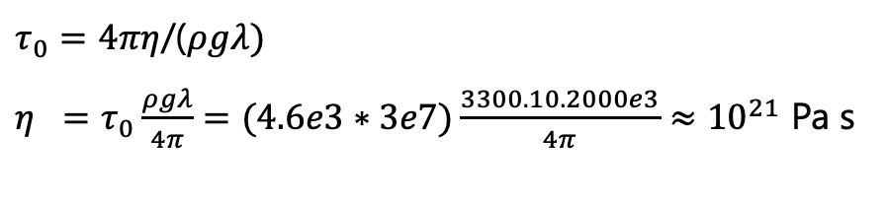
Postglacial rebound: Estimating viscosity
Fennoscandia ice sheets melted at about 11,000 years before present. Since then, relative sea-level in those regions has been falling, indicating uplift.
$τ_{0}=4πη$/($ρgλ)$
$η =τ_{0}\frac{ρgλ}{4π}=(4.6e3∗3e7)\frac{3300.10.2000e3}{4π}≈{10}^{21}$ Pa s

Slide 28
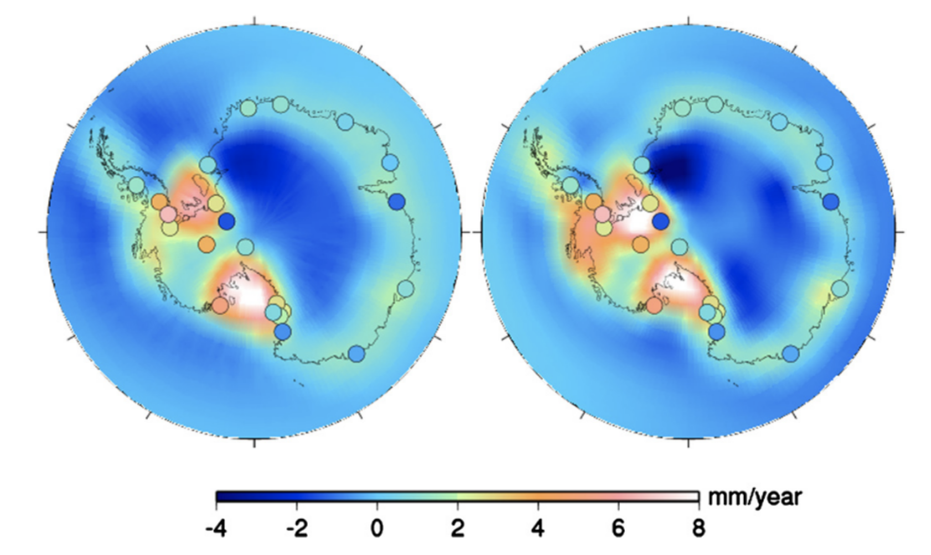
Modern glacial isostatic adjustment research
How do spatially variable mantle viscosities (e.g., due to thermal anomalies, melt) impact spatial patterns of postglacial rebound
Van der Wal et al., 2015, EPSL

Slide 29
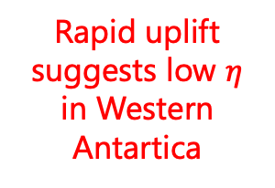
Modern glacial isostatic adjustment research
How do spatially variable mantle viscosities (e.g., due to thermal anomalies, melt) impact spatial patterns of postglacial rebound
Van der Wal et al., 2015, EPSL
Rapid uplift suggests low $η$ in Western Antartica

Slide 30
Modern glacial isostatic adjustment research
How do spatially variable mantle viscosities (e.g., due to thermal anomalies, melt) impact spatial patterns of postglacial rebound
Van der Wal et al., 2015, EPSL
Rapid uplift suggests low $η$ in Western Antartica
Important for understanding how the ice sheet will evolve in the future (under continued warming and melting)

Slide 31
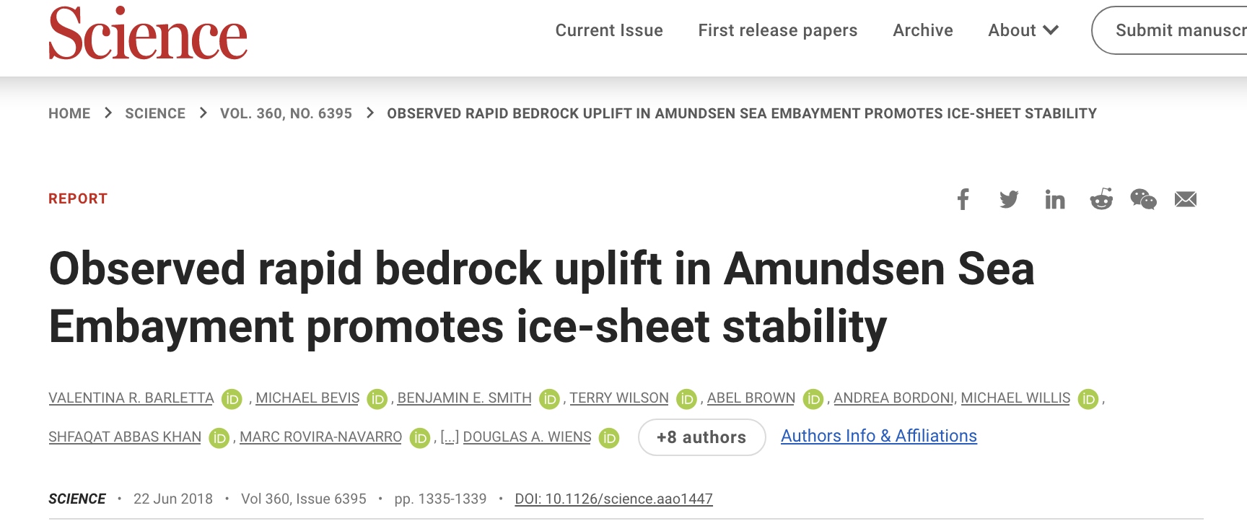
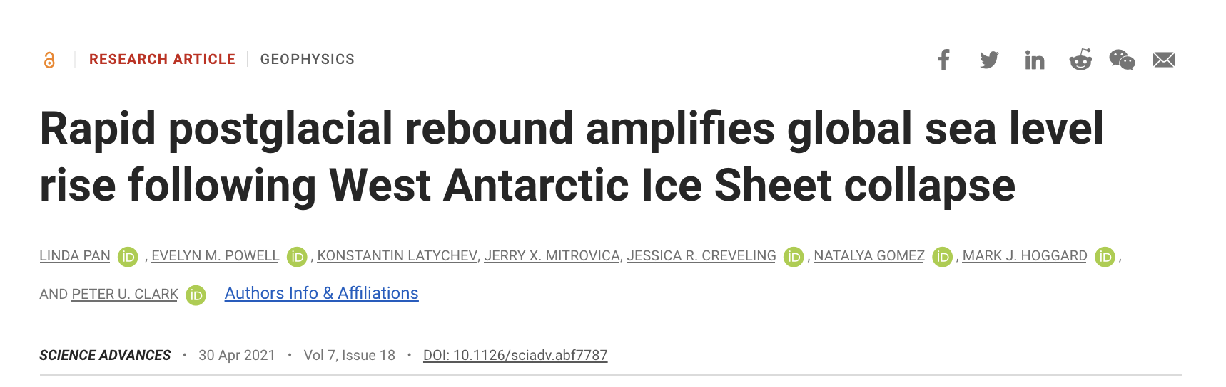
Modern glacial isostatic adjustment research
How do spatially variable mantle viscosities (e.g., due to thermal anomalies, melt) impact spatial patterns of postglacial rebound
Van der Wal et al., 2015, EPSL
Rapid uplift suggests low $η$ in Western Antartica
Important for understanding how the ice sheet will evolve in the future (under continued warming and melting)

Slide 32
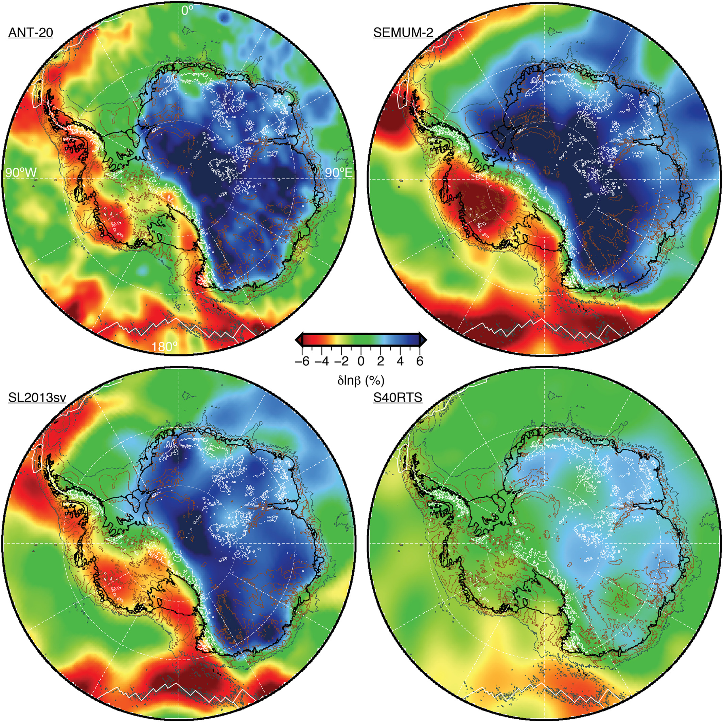
Fast shear wave speeds in seismic tomography
Melting associated with Cenozoic rift and volcanic system?

Slide 33
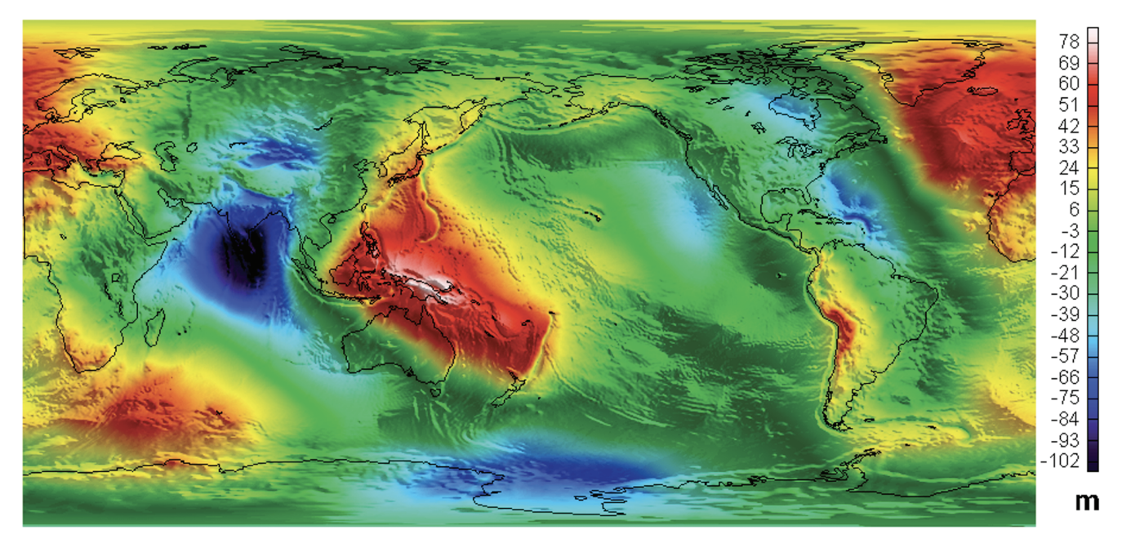
The Geoid also an important constraint on mantle $η$
The geoid is Earth’s equipotential gravity surface. It’s the shape the ocean would take (under gravity) without topography. Gravitational acceleration acts perpendicular to the geoid surface.
Notes:
Fig. 2. (a) The geoid anomaly over a positive mass anomaly (stippled) in a static earth. (b) The dynamic flow driven by the mass anomaly causes negative mass anomalies (stripped regions) at the upper and lower boundaries, hence negative geoid anomalies. The sum of (a) and (b) is a negative anomaly in a uniform viscosity medium. (c) With an increased viscosity in the lower layer, the dynamic topography of the surface is reduced and the sum of (a) plus (c) could be positive

Slide 34
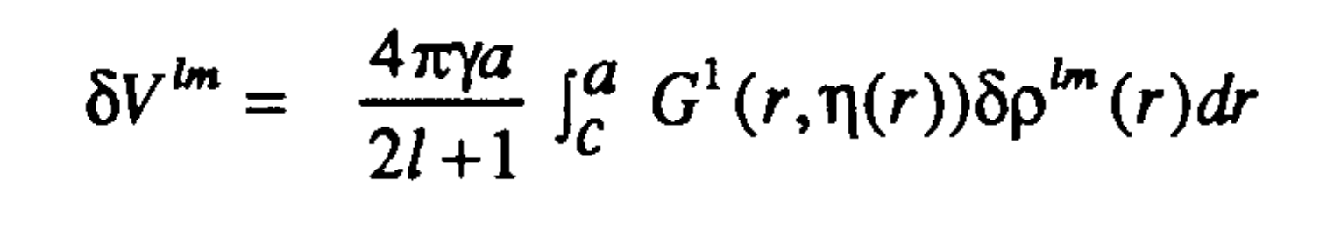
The Geoid also an important constraint on mantle $η$
The geoid is Earth’s equipotential gravity surface. It’s the shape the ocean would take (under gravity) without topography. Gravitational acceleration acts perpendicular to the geoid surface.
The geoid a function of mantle density anomalies modulated by radial sensitivity functions that depend on viscosity, e.g.:
Notes:
Fig. 2. (a) The geoid anomaly over a positive mass anomaly (stippled) in a static earth. (b) The dynamic flow driven by the mass anomaly causes negative mass anomalies (stripped regions) at the upper and lower boundaries, hence negative geoid anomalies. The sum of (a) and (b) is a negative anomaly in a uniform viscosity medium. (c) With an increased viscosity in the lower layer, the dynamic topography of the surface is reduced and the sum of (a) plus (c) could be positive

Slide 35
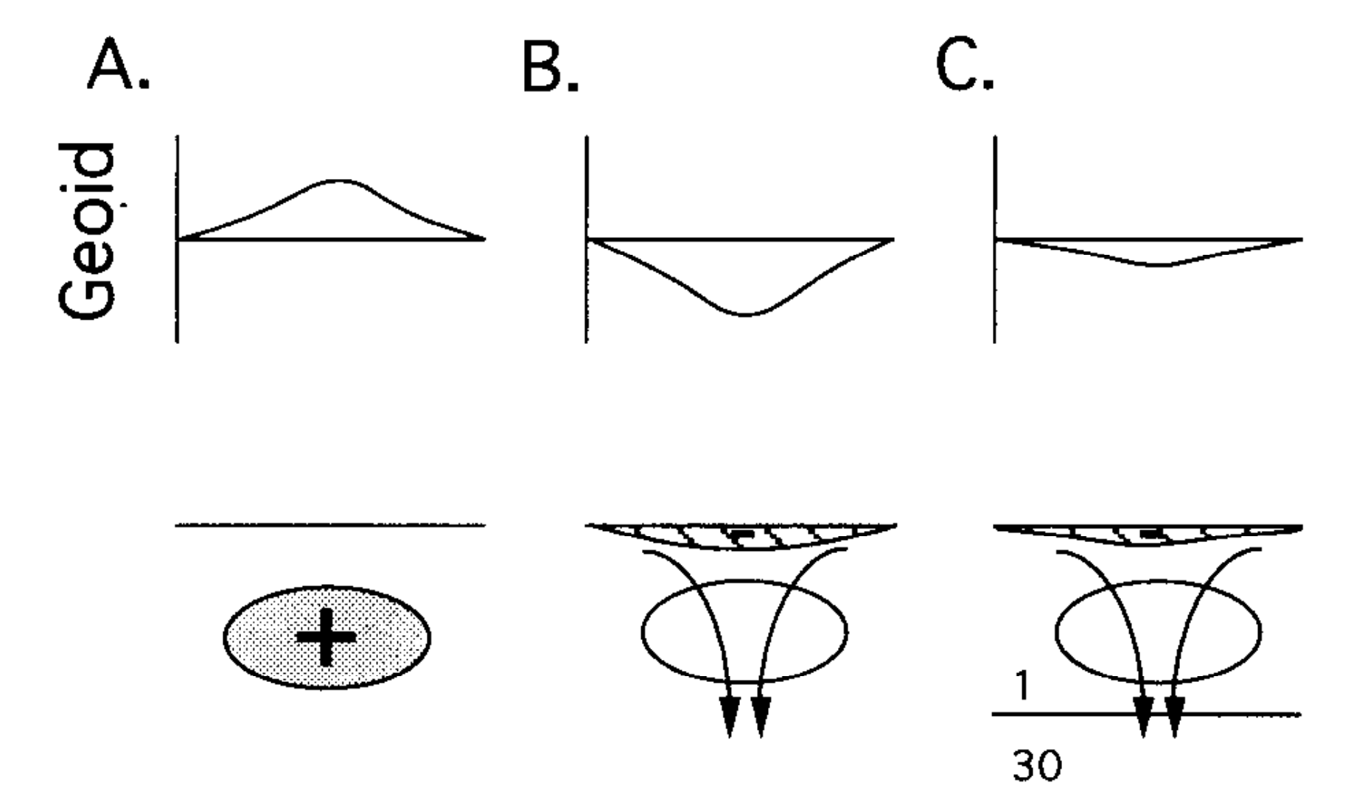
The Geoid also an important constraint on mantle $η$
The geoid is Earth’s equipotential gravity surface. It’s the shape the ocean would take (under gravity) without topography. Gravitational acceleration acts perpendicular to the geoid surface.
The geoid a function of mantle density anomalies modulated by radial sensitivity functions that depend on viscosity, e.g.:
King, 1995, AGU
Notes:
Fig. 2. (a) The geoid anomaly over a positive mass anomaly (stippled) in a static earth. (b) The dynamic flow driven by the mass anomaly causes negative mass anomalies (stripped regions) at the upper and lower boundaries, hence negative geoid anomalies. The sum of (a) and (b) is a negative anomaly in a uniform viscosity medium. (c) With an increased viscosity in the lower layer, the dynamic topography of the surface is reduced and the sum of (a) plus (c) could be positive

Slide 36
The Geoid also an important constraint on mantle $η$
The geoid is Earth’s equipotential gravity surface. It’s the shape the ocean would take (under gravity) without topography. Gravitational acceleration acts perpendicular to the geoid surface.
The geoid a function of mantle density anomalies modulated by radial sensitivity functions that depend on viscosity, e.g.:
King, 1995, AGU
Hence can assume we know mantle density (debatable) and invert the geoid for mantle viscosity
Notes:
Fig. 2. (a) The geoid anomaly over a positive mass anomaly (stippled) in a static earth. (b) The dynamic flow driven by the mass anomaly causes negative mass anomalies (stripped regions) at the upper and lower boundaries, hence negative geoid anomalies. The sum of (a) and (b) is a negative anomaly in a uniform viscosity medium. (c) With an increased viscosity in the lower layer, the dynamic topography of the surface is reduced and the sum of (a) plus (c) could be positive

Slide 37
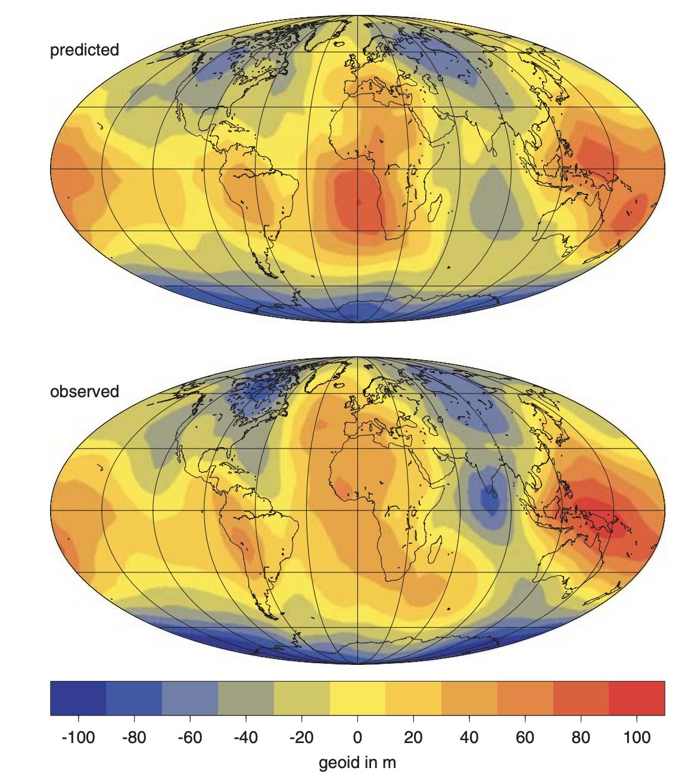
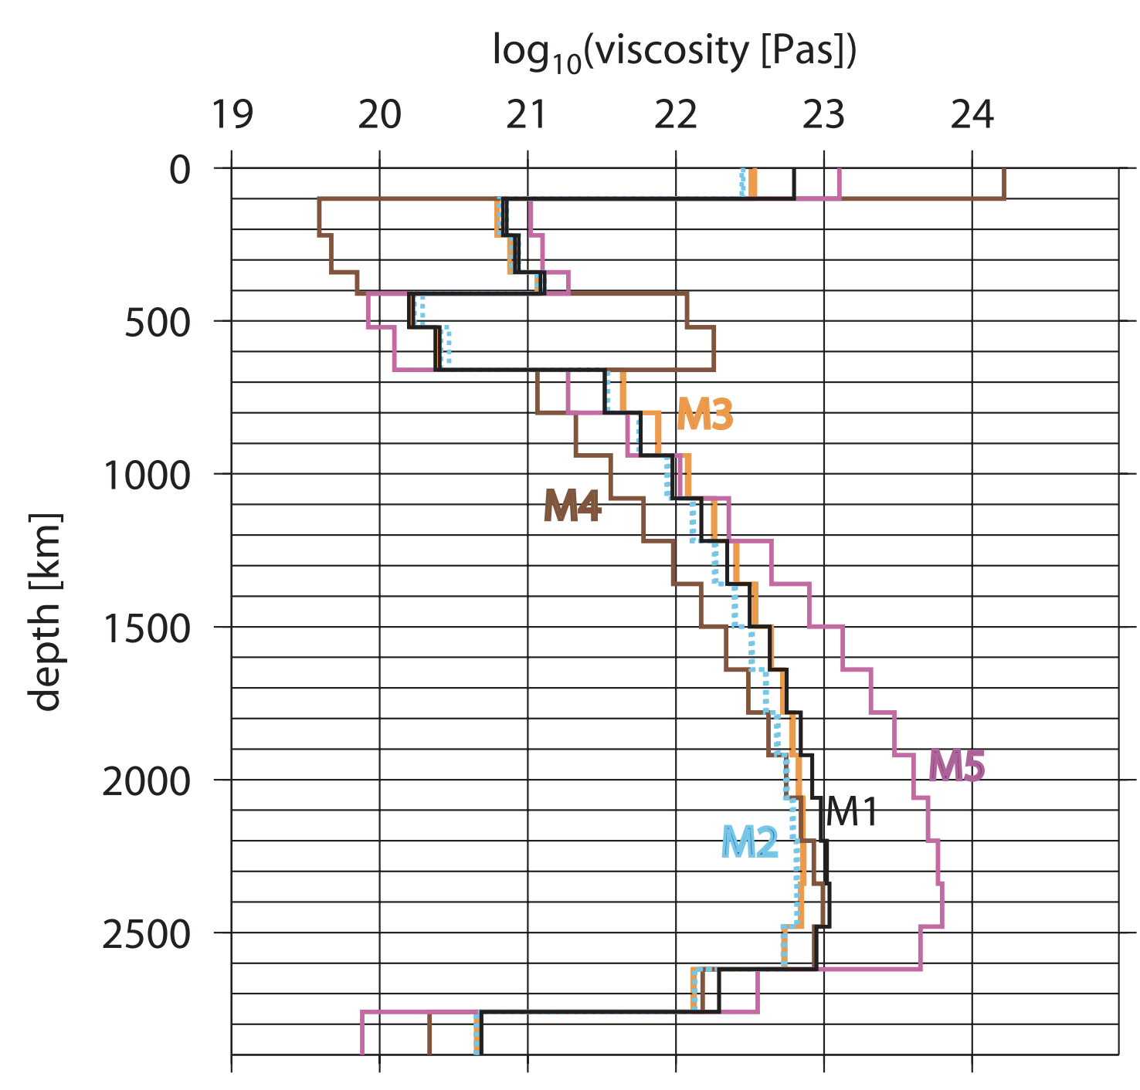
The Geoid also an important constraint on mantle $η$
Steinberger and Calderwood, 2006, GJI

Slide 38
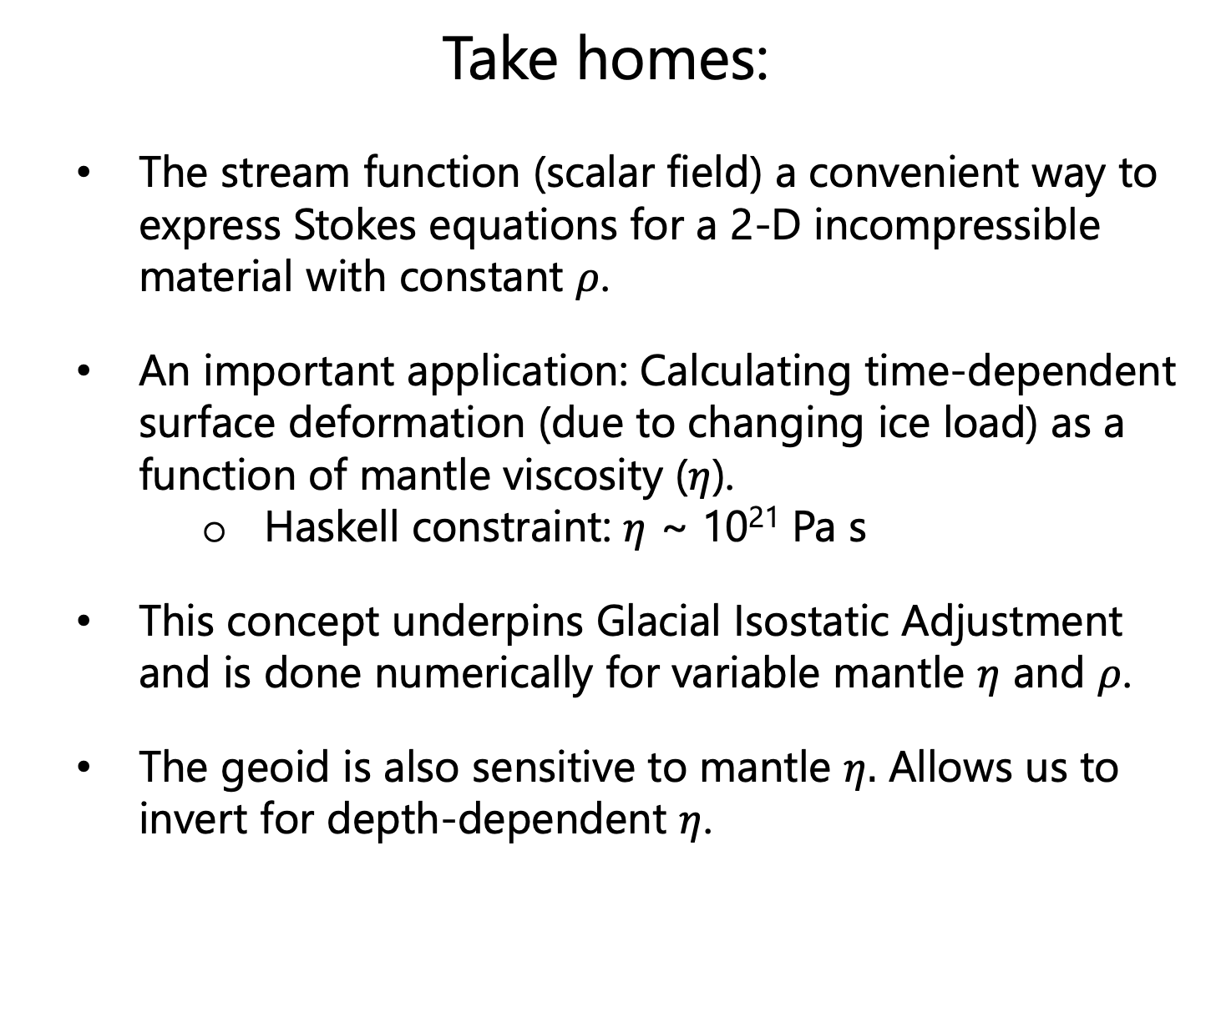
Take homes:
The stream function (scalar field) a convenient way to express Stokes equations for a 2-D incompressible material with constant $ρ$.
An important application: Calculating time-dependent surface deformation (due to changing ice load) as a function of mantle viscosity ($η$).
Haskell constraint: $η$ ~ 10²¹ Pa s
This concept underpins Glacial Isostatic Adjustment and is done numerically for variable mantle $η$ and $ρ$.
The geoid is also sensitive to mantle $η.$ Allows us to invert for depth-dependent $η$.

